Slide 1

Welcome to
HOD and Members of organizing committee,
Dept.of Mechanical Engg, SRIT, Ananthapuramu,
Review of Project Work
By
S.SHAHID SALMAN 194G1A0388
R VENKATAPATHI NAIDU 194G1A03A3
R VINAY KUMAR REDDY 194G1A03A6
K VISHNU PRIYA 194G1A03A8
S SHAHIR 204G5A0320
V VASANTH KUMAR 204G5A0322
Under the guidance of
Mrs.T Kiranmayee M.Tech
Assistant Professor of ME, SRIT
Mechanical Engg, SRIT, Ananthapuramu

Slide 2

ANALYSIS & FABRICATION OF
AUTOMATIC B-CRADLE
By
S SHAHID SALMAN 194G1A0388
R VENKATAPATHI NAIDU 194G1A03A3
R VINAY KUMAR REDDY 194G1A03A6
K VISHNU PRIYA 194G1A03A8
S SHAHIR 204G5A0320
V VASANTH KUMAR 204G5A0322
Under the guidance of
Mrs.T. Kiranmayee M.Tech,
Assistant Professor , SRIT
Mechanical Engg, SRIT, Ananthapuramu

Slide 3
OUTLINES OF THE PRESENTATION
Abstract
Introduction
Literature review
Definition of the problem
Objectives
Experiment design
Equipment procured
References

Slide 4
ABSTRACT
The Regular Automatic child cradle foundation are mainly high end and they in addition do not offer much practicality.
In recent times the progress of high-tech electronics has introduced the concept of intelligent baby cradle as a smart system with many features to minimize the efforts of parents and guardians.
There is a need to develop a new low-cost indigenous electronic cradle because the existing cradles are imported and costly.
In this project the design and implementation of a new indigenous low-cost Smart Baby Cradle that soothes the baby with some soft music when the baby cries, for this it has a cry analyzing system which detects the baby’s cry and accordingly the cradle plays some soft music for the baby to stop crying

Slide 5
INTRODUCTION
In today's world, everyone is busy in its own life.
Nowadays, even the mothers are working and there is a requirement of unattended cradle. The proposed E-Cradle is a novel solution to this problem.
In the proposed design, there will be a circuit placed along the cradle which will sense the sound intensity of the cry of the child and takes necessary actions based on the sound intensity of the child's cry.
Generally, the baby cradle is used to relax and help the baby fall asleep. For example, parents must look after their child till the infant goes to sleep. However, traditional cradle does not have provisions such as a battery or an adapter to automate the cradle.
These traditional cradles are more common in villages or rural areas due to its less cost and availability. But the fact is that we need human beings to take care of infant and your baby might not feel safe and comfortable in the normal cradle system. so, we would like automate the cradle system to take care of infant that consists of an independent power source.

Slide 6
LITERATURE REVIEW
Marie R. Harper, La Mirada Maxine R. Blea, conducted a work on a baby crib or cradle adapted to be rocked automatically by an oscillatory action motor having the same effect. Thelower portion or bottom of the crib is adapted to be connected to the motor. The motor also includes a regulating, reciprocating means for imparting the actuating movement of the crib in a smooth-rocking motion.
Steven Bang designed automatic baby rocker having a noise sensor to detect baby cry. Signal from noise sensor is fed to microcontroller Arduino ATmega 328, which is used to control the DC motor. Few colorful lights made up of LED are used to entertain the baby while being rocked.
M. P. Joshi and D. C. Mehetre, have designed a cradle system with an android app to monitor baby, which swings automatically after detection of baby crying sound and also an SMS is sent to parent phone using GSM module. Additionally a camera is placed at top connected with cloud server so that parent can request video from camera from any place.
Yang HU developed an algorithm to control the speed of motors based on the parameters obtained from baby monitoring this model help the user to control the speed of swinging on pattern of intensity of baby crying.
S. Kavitha, R. R. Neela, M. Sowndarya, Madhuchandra and K. Harshitha, introduced a framework which observe all necessary indication of the child like heartbeats and the internal heat level utilizing remote innovation and sound sensors which is used for observing the cry pattern of the child. Additionally, the live images of the infant is obtained through cameramodule through a Wide Area Network (WAN) which can be sent through mail and it can keep surveillance on the baby from distant areas around the world. It keeping an eye on the infants development in a limited area.

Slide 7
Definition of the problem
After study of all the literature related automatic baby cradle. We understand that taking care for a baby is most important.
Now a days some parents after their work they are mentally stressed and tried so they are not able to take care for the baby.
We decide to remove the stress for the parents and comfort for the baby. The baby cradle is used to relax and help the baby fall asleep.
Gathering information and data related to the automatic baby cradle components like servo motor, ardunio, GSM module, wifi modules, sound sensor and moisture sensor.
We are using Iot for storing the data and selected best cradle design which gives comfort sleep for the baby.
we are started work to implement automatic swing moment through ardunio.

Slide 8
Objectives of work
Design the best cradle for baby through design software like Catia v5, Autocad etc
When the baby cry the cradle has to swing automatic with the help of sound sensor and servo motor
If the baby crying continuously more than 5 minutes, it send a Msg to parent mobile through Gsm module
Moisture sensor detects in cradle when baby urinate and send signal to ardunio

Slide 9
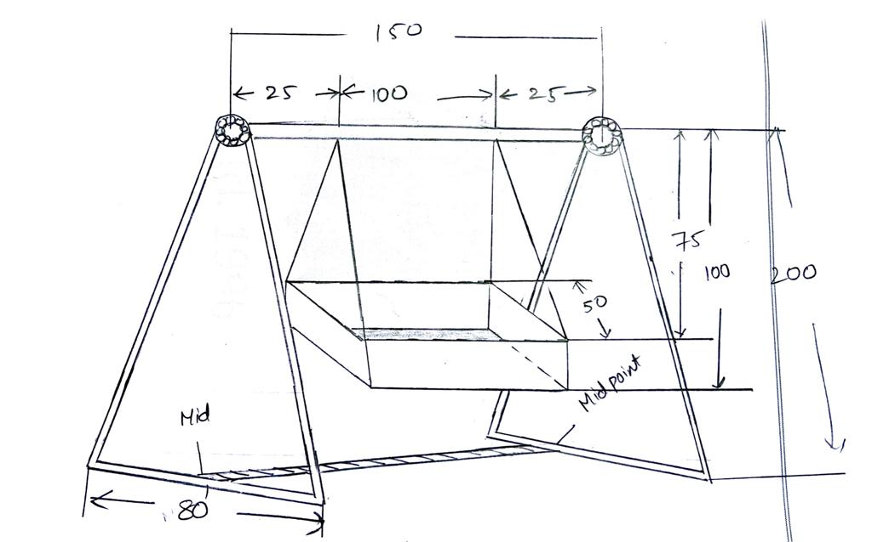
Proposed Experimental design

Slide 10
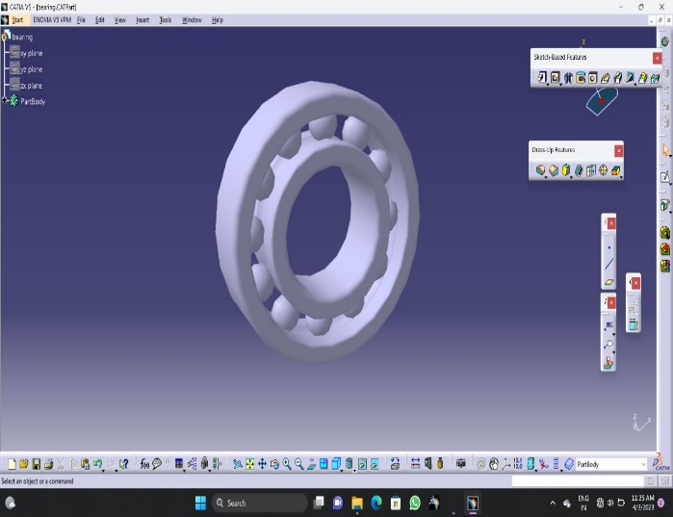
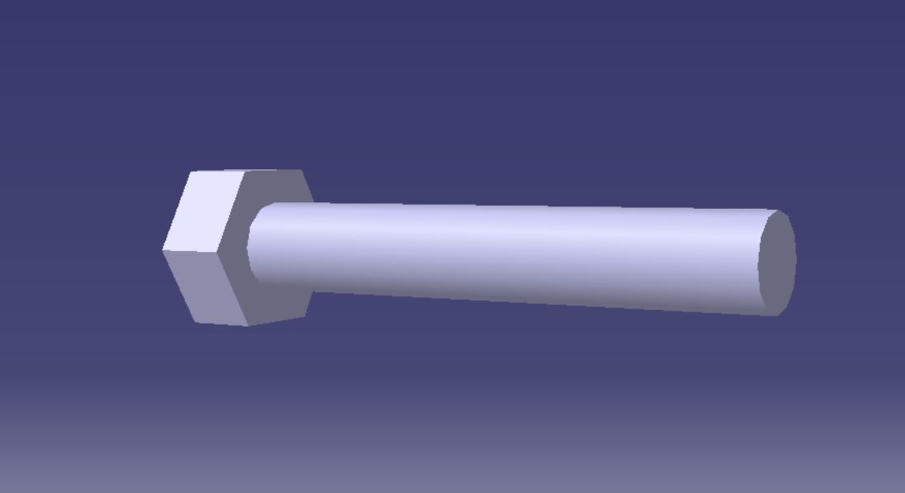
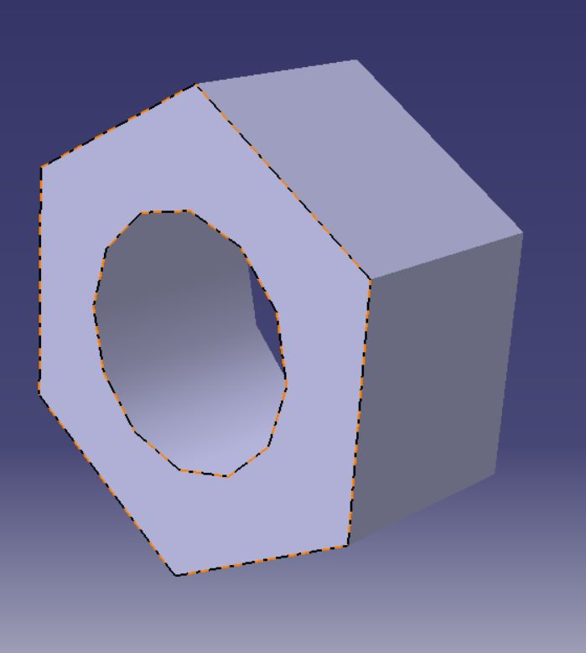
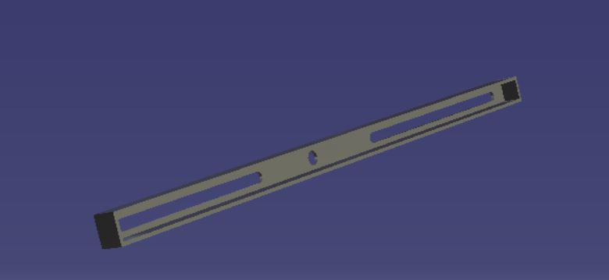
Figure 1: Ball bearing
Figure 2: ball bracket
Figure 3: Bracket nut
Figure 4: slotter lever

Slide 11
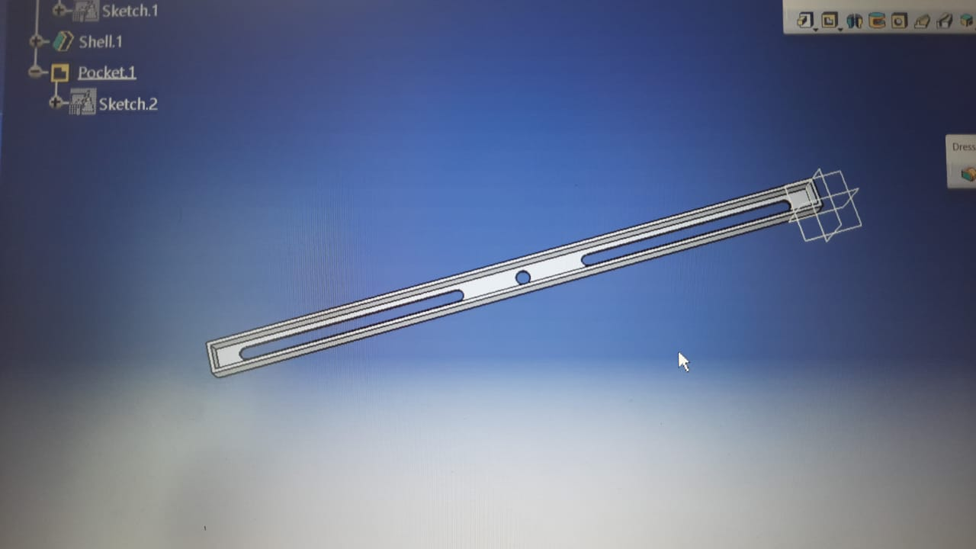
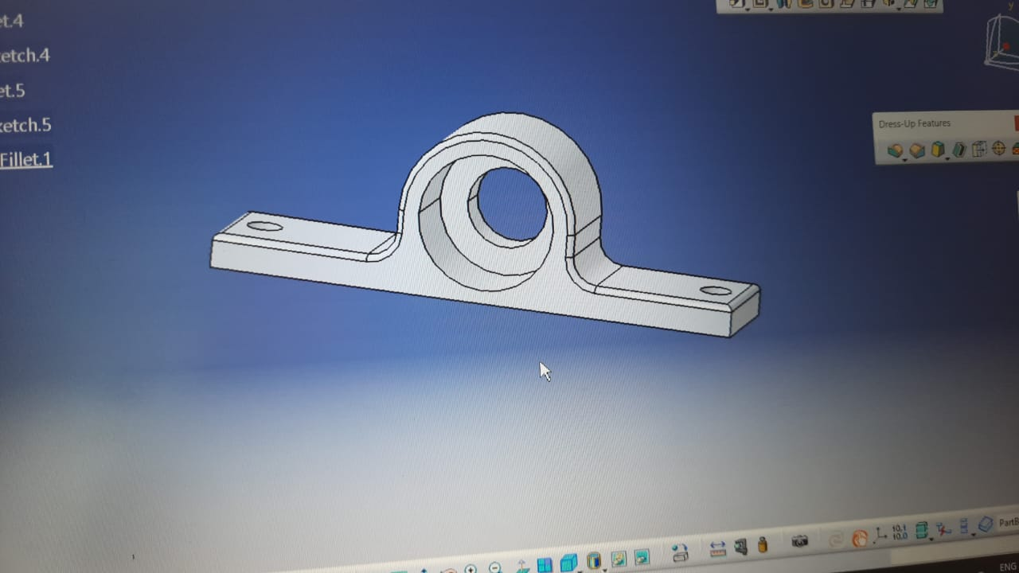
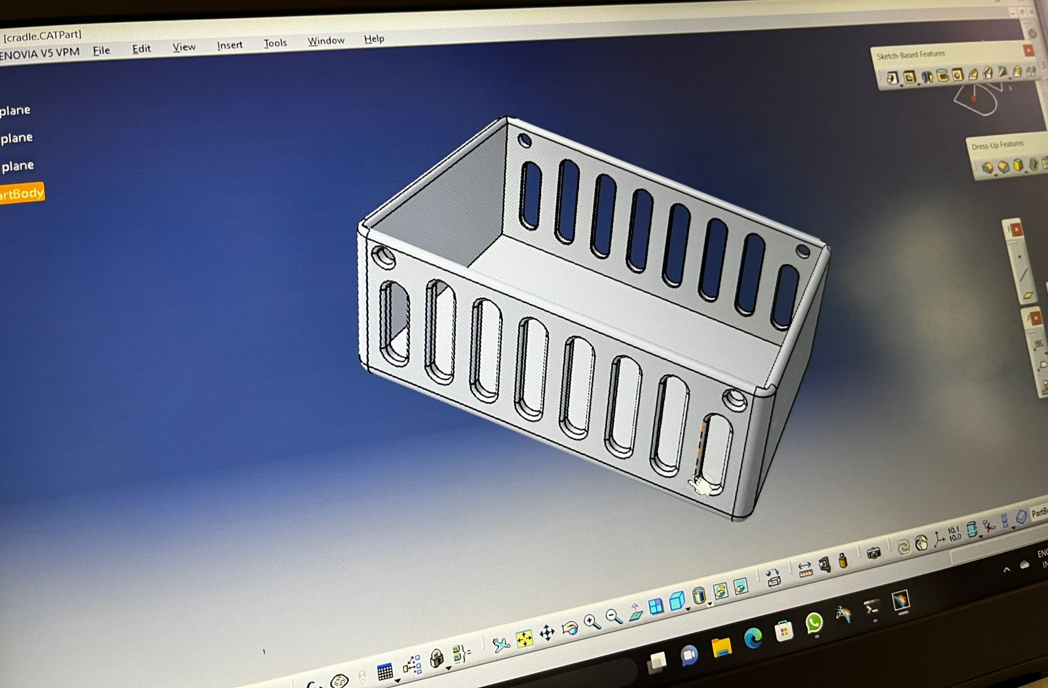
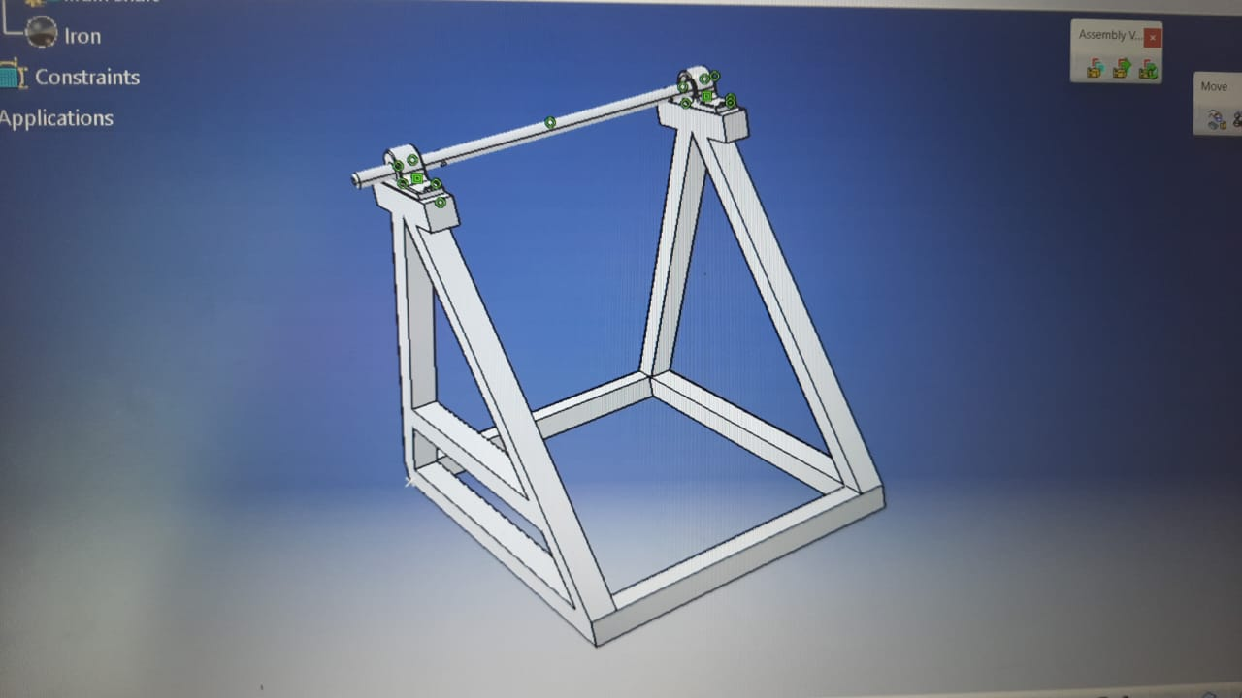

Slide 14
Equipment Procured
Cradle
Servo Motor
Ardunio
Gsm module
Wifi module
Sensors like moisture, sound sensor

Slide 15
Fig1 : Cradle
Fig2: sound sensor
Fig3: Moisture sensor
Fig4: Ardunio

Slide 16
REFERENCES
Steven Bang; Richard Lam; Natallia Lo Cicero (2011), “Rock Me Baby: The Automatic Baby Rocker” Project for, SanJose State University, Department of Mechanical and Aerospace Engineering,.
Acredolo, L. and Goodwyn, S “ putting Energy into Vibration, from journal publish in 2000”,Graph Frequency of vibration of the swing...2000.
Andrews, L. “For Baby Swing Consideration before Installing Baby Swing, Automatic baby swing”. 2002.
A.L. Schwab, J.P. Meijaard, and P. Meijers, “A comparison of revolute joint clearance model in the dynamic analysis of rigid and elastic mechanical systems,” Mechanism and Machine Theory, vol. 37, no. 9, pp. 895- 913, 2002.
Chau-Kai-Hsieh; Chiung Lin; Taiwan; “Baby Cry Recognizer” US 5668780, Date of Patent ,1997.
Cabrera J A, Simon A and Prado M (2002), “Optimal Synthesis of Mechanisms with Genetic Algorithm”,Mechanism and Machine Theory, ol. 37, No. 10, pp. 1165-1177.
Chiou S-J and Kota S (1999), “Automated Conceptual Design of Mechanisms”, Mechanism and Machine Theory, Vol. 34, No. 3, pp. 467-495.
Christiaan Huygen (1665) observed that the cradle link harmonic oscillator and the system models have a single degree of freedom.
Christenson, T. R., Schmale, D. T., 1999, “A Batch Wafer Scale LIGA Assembly and Packaging Technique Via Diffusion Bonding,” Twelfth IEEE International Conference on Microelectromechanical microphone sensig Systems, 17 - 21 Jan. 1999, pp. 476 - 481.
E.Ngale Haulin, A.A. Lakis, & Ravine, “Optimal synthesis of a cardle link mechanism used in hand prosthesis”, Mechanism and Machine Theory , 2000, 36, 1203- 1214.
G. Gilardi, and I. Sharf, “Literature survey of contact dynamics mode-ling,” Mechanism and Machine Theory, vol. 37, no. 10, pp. 1213-1239, 2002.
Gim Wong, “Automatic baby crib rocker” US 3952343, Date of Patent:,1976.
Anritha Ebenezer, Anupreethi. S,“Automatic Cradle Movement for Infant Care” Coimbatore, India.

Slide 17
THANK YOU

